Slide 1

Windy: A Machine learning based climate and weather predictor
Ayushi Kareena(41120035)
Caroline Pricy(41120045)
BATCH NO: 26
Guide
Dr. S. Urmela, M.Tech.,Ph.D.,
Associate Professor

Slide 2
ABSTRACT
Windy is an innovative ML-based system designed to improve climate and weather predictions. It integrates extensive datasets from satellites, weather stations, and historical records, utilizing advanced machine learning models like RNNs and CNNs to process sequential and spatial data. These models identify complex patterns and provide high-resolution, real-time forecasts. Windy enhances predictive accuracy through ensemble learning methods and includes climate change scenarios for long-term projections alongside short-term forecasts. Its user-friendly interface offers visualizations, severe weather alerts, and customizable options. By delivering precise and reliable forecasts, Windy supports better-informed decision-making in agriculture, disaster management, and everyday activities. This contributes to enhanced preparedness for weather-related events. Windy represents a significant advancement in climate and weather prediction technology, ultimately providing precise, reliable, and timely forecasts.
School of Computing
2

Slide 3
LITERATURE SURVEY
S. K. Panda and P. Ray, "A Survey on Weather Prediction using Big Data and Machine Learning Techniques," 2023 5th International Conference on Energy, Power and Environment: Towards Flexible Green Energy Technologies (ICEPE), Shillong, India, 2023, pp. 1-6, doi: 10.1109/ICEPE57949.2023.10201614.
Description:
The paper "A Survey on Weather Prediction using Big Data and Machine Learning Techniques" explores integrating big data analytics with machine learning for weather forecasting. It discusses algorithms like neural networks, support vector machines, and decision trees, emphasizing their use in atmospheric science. The study addresses challenges in processing big data and creating reliable prediction models. It highlights the impact of weather forecasting across various fields and the importance of advanced analytics.
Merits:Provides a comprehensive overview of machine learning solutions applied to weather forecasting.Emphasizes the necessity of big data for improving the accuracy of weather predictions.
Demerits: Lacks systematic categorization and detailed description of methods used.
Does not offer an in-depth analysis of the results from included studies.
School of Computing
3

Slide 4
A. Shaji, A. R. Amritha and V. R. Rajalakshmi, "Weather Prediction Using Machine Learning
Algorithms," 2022 International Conference on Intelligent Controller and Computing for Smart
Power (ICICCSP), Hyderabad, India, 2022, pp. 1-5, doi:
10.1109/ICICCSP53532.2022.9862337.
Description:
The paper "Weather Prediction Using Machine Learning Algorithms" investigates the use of machine learning for weather prediction, focusing on hybrid models combining different algorithms for improved results. Methods like Random Forest, Linear Regression, Decision Tree, and MLP Classifier are used and compared, showing that hybrid models can outperform stand-alone solutions. The study demonstrates that machine learning methods can provide accurate predictions using shared historical data from nearby regions, even on limited resources and various production-ready machines.
Merits:Demonstrates how hybrid machine learning models significantly improve weather prediction accuracy. Highlights the value of using historical data from neighboring regions and the lightweight nature of the models for deployment on various devices.
Demerits:Some hybrid models do not consistently improve prediction performance for all downstream tasks. The approach may be less effective when forecasting without considering neighboring regions, requiring further tuning and model testing.
School of Computing
5

Slide 5
A. A. Patil and K. Kulkarni, "A Hybrid Machine Learning - Numerical Weather Prediction Approach for Rainfall Prediction," 2023 IEEE India Geoscience and Remote Sensing Symposium (InGARSS), Bangalore, India, 2023, pp. 1-4, doi: 10.1109/InGARSS59135.2023.10490397
Description:
The paper "A Hybrid Machine Learning Numerical Weather Prediction Approach for Rainfall Prediction" explores combining machine learning techniques with numerical weather prediction (NWP) models. It compares the performance of ML models like XGBoost and Neural Networks with traditional Linear SVM models using F1 scores and MAE. The study highlights advancements in prediction accuracy across various lead times, demonstrating the potential of ML to enhance weather forecasts.
Merits:
Machine learning significantly improves prediction accuracy and reliability, with higher F1-scores and lower MAE than traditional methods.These techniques are computationally efficient and can run on standard computing devices, including mobile platforms.
Demerits:
Machine learning models require large, high-quality datasets, which can be challenging to obtain and suffer reduced accuracy over longer lead times.
School of Computing
6

Slide 6
Y. Mizuno, M. Tanaka, Y. Tanaka, F. Kurokawa and N. Matsui, "A Prediction of Power Demand using Weather Forecasting and Machine Learning: A Case of a Clinic in Japan," 2022 10th International Conference on Smart Grid (icSmartGrid), Istanbul, Turkey, 2022, pp. 190-193, doi: 10.1109/icSmartGrid55722.2022.9848544.
Description:
The paper "A Prediction of Power Demand using Weather Forecasting and Machine Learning: A Case of a Clinic in Japan" discusses a method for predicting power demand in medical facilities using weather forecasting data and machine learning. This approach integrates weather information from the Japan Meteorological Agency (JMA) with clinical load data to create accurate power demand forecasts using MATLAB.
Merits:
The proposed model leverages actual clinical and weather data, achieving a high accuracy of power demand predictions with RMSE/MAE ratios of 1.37 and 1.50 for June 2021 and February 2022, respectively.
Demerits:
The reliance on historical weather and load data may limit the model's adaptability to sudden, unforeseen changes in weather patterns or clinic activities.
School of Computing
7

Slide 7
S. Madan, P. Kumar, S. Rawat and T. Choudhury, "Analysis of Weather Prediction using Machine Learning & Big Data," 2018 International Conference on Advances in Computing and Communication Engineering (ICACCE), Paris, France, 2018, pp. 259-264, doi: 10.1109/ICACCE.2018.8441679.
Description:
The use of machine learning and weather forecasting for predicting power demand and weather conditions is a growing field. The application in a Japanese clinic shows how these technologies can optimize energy use based on weather data. This involves the use of neural networks and regression models to make accurate predictions. Machine learning models, such as linear regression and support vector machines, have shown promising results in reducing prediction errors and improving efficiency.
Merits:
This approach leads to highly accurate and reliable forecasts, enhancing the efficiency of energy management in facilities.
Demerits:
The model's accuracy heavily depends on the quality and quantity of data, which can be a limitation.
School of Computing
8

Slide 8
A. Parashar, "IoT Based Automated Weather Report Generation and Prediction Using Machine Learning," 2019 2nd International Conference on Intelligent Communication and Computational Techniques (ICCT), Jaipur, India, 2019, pp. 339-344, doi: 10.1109/ICCT46177.2019.8968782.
Description:
The document "IoT Based Automated Weather Report Generation and Prediction Using Machine Learning" describes a system that utilizes IoT and machine learning for weather prediction. The system collects data from various sensors and uploads it to the cloud for processing and analysis.
Merits:
Real-time data collection enhances prediction accuracy, and using machine learning models allows for efficient processing and analysis of large datasets.
Demerits:
Reliance on internet connectivity can cause data upload issues, and sensor malfunctions or interference can lead to inaccurate weather predictions.
School of Computing
9

Slide 9
S. E. Haupt, J. Cowie, S. Linden, T. McCandless, B. Kosovic and S. Alessandrini, "Machine Learning for Applied Weather Prediction," 2018 IEEE 14th International Conference on e?Science (e-Science), Amsterdam, Netherlands, 2018, pp. 276-277, doi: 10.1109/eScience.2018.00047
Description:
The National Center for Atmospheric Research (NCAR) uses machine learning for weather forecasting, exemplified by the Dynamic Integrated foreCasting (DICast®) System. DICast combines numerical weather prediction models and historical observations to optimize forecast accuracy. This system, along with other AI technologies, is applied in renewable energy, surface transportation, and wildfire forecasting. NCAR's AI-based advancements enhance the accuracy and reliability of weather forecasts.
Merits:
It enhances decision-making in various fields like renewable energy and transportation, providing timely and precise information.
Demerits:
The reliance on large datasets and computational resources can be a limitation, making implementation challenging for resource-constrained environments.
School of Computing
10

Slide 10
F. Raimundo, A. Glória and P. Sebastião, "Prediction of Weather Forecast for Smart Agriculture supported by Machine Learning," 2021 IEEE World AI IoT Congress (AIIoT), Seattle, WA, USA, 2021, pp. 0160-0164, doi: 10.1109/AIIoT52608.2021.9454184.
Description:
The study evaluates machine learning regression techniques for predicting weather conditions in agricultural fields, focusing on smart irrigation systems. Various models, including Linear Regression, Decision Trees, Random Forests, and Neural Networks, were compared. Random Forest and Decision Tree models showed the highest efficiency after cross-validation. The approach aims to provide accurate predictions for temperature, precipitation, wind speed, and evapotranspiration based on field location and date. This ultimately supports more efficient and autonomous agricultural practices.
Merits:
Machine learning in smart agriculture enhances prediction accuracy for critical weather parameters, leading to more efficient irrigation and resource management.
Demerits:
Implementing machine learning models requires substantial computational resources and high-quality datasets, which may be challenging for smaller farms.
School of Computing
11

Slide 11
A. Catalina, C. M. Alaíz and J. R. Dorronsoro, "Combining Numerical Weather Predictions and Satellite Data for PV Energy Nowcasting," in IEEE Transactions on Sustainable Energy, vol. 11, no. 3, pp. 1930-1937, July 2020, doi: 10.1109/TSTE.2019.2946621.
Description:
The integration of numerical weather predictions (NWP) and satellite data significantly enhances photovoltaic (PV) energy nowcasting. This study combines NWP and satellite data to predict hourly PV energy production for up to six hours in Peninsular Spain, Majorca, and Tenerife. The combined approach outperforms methods relying solely on either data source. This improved forecasting supports the growing reliance on PV energy by providing accurate, timely predictions crucial for grid stability and energy market operations.
Merits:
Combining NWP and satellite data increases prediction accuracy and reliability, crucial for managing PV energy's variable nature.
Demerits:
The approach requires extensive computational resources and access to high-quality satellite data, which might be challenging in less developed regions.
School of Computing
12

Slide 12
S. Iram et al., "An Innovative Machine Learning Technique for the Prediction of Weather Based Smart Home Energy Consumption," in IEEE Access, vol. 11, pp. 76300-76320, 2023, doi: 10.1109/ACCESS.2023.3287145.
Description:
The research presents an innovative machine learning technique for predicting smart home energy consumption based on weather data from a Kaggle dataset. This dataset includes electricity consumption readings, household appliance usage, and weather data. After cleaning, normalizing, and transforming the data, the study found that temperature significantly impacts energy consumption patterns in smart homes.
Merits:
This technique offers precise energy consumption predictions, helping in energy management and optimization. It enhances understanding of weather impacts on energy use, aiding in smarter decision-making for energy conservation.
Demerits:
The approach requires extensive data preprocessing and may face challenges in handling large datasets efficiently.
School of Computing
13

Slide 13
J. L. Aznarte and N. Siebert, "Dynamic Line Rating Using Numerical Weather Predictions and Machine Learning: A Case Study," in IEEE Transactions on Power Delivery, vol. 32, no. 1, pp. 335-343, Feb. 2017, doi: 10.1109/TPWRD.2016.2543818.
Description:
The study "Dynamic Line Rating Using Numerical Weather Predictions and Machine Learning" explores combining NWP models with machine learning to improve power transmission line efficiency and reliability. Dynamic Line Rating (DLR) allows real-time adjustments to transmission line thermal ratings based on current weather conditions, optimizing capacity. This approach uses historical weather data and advanced algorithms to predict power line ampacity. It enables better energy resource management and reduces grid overload risk.
Merits:
The integration of NWP and machine learning improves the accuracy of ampacity forecasts, optimizes the utilization of power lines, and enhances grid reliability
Demerits:
Challenges include the need for high-quality weather data, the complexity of implementing real-time DLR systems, and the potential for increased computational costs.
School of Computing
14

Slide 14
M. Alqudah and Z. Obradovic, "Enhancing Weather-Related Outage Prediction and Precursor Discovery Through Attention-Based Multi-Level Modeling," in IEEE Access, vol. 11, pp. 94840- 94851, 2023, doi: 10.1109/ACCESS.2023.3303110.
Description:
The study "Enhancing Weather-Related Outage Prediction and Precursor Discovery Through Attention-Based Multi-Level Models" aims to predict power outages from weather events using advanced machine learning techniques. It employs non-parametric attention mechanisms to capture complex relationships within the power grid, improving prediction accuracy. By using data on transmission line outages and weather conditions, the models enhance grid resilience and outage management.
Merits:
The model improves prediction accuracy for weather-related power outages, aiding in better grid management and resilience.
Demerits:
The model's effectiveness is limited by the granularity of available outage data and the lack of internal grid data.
School of Computing
15

Slide 15
P. Du, "Ensemble Machine Learning-Based Wind Forecasting to Combine NWP Output With Data From Weather Station," in IEEE Transactions on Sustainable Energy, vol. 10, no. 4, pp. 2133-2141, Oct. 2019, doi: 10.1109/TSTE.2018.2880615.
Description:
The study investigates the effectiveness of machine learning algorithms in predicting short-term rainfall amounts using weather data from Uganda. It evaluates models including Support Vector Machines (SVM), Artificial Neural Networks (ANN), and Random Forests (RF). The research involves preprocessing weather data, training these models, and comparing their predictive accuracy. The aim is to improve short-term rainfall predictions, which are crucial for agricultural planning and disaster management in Uganda.
Merits:
The study provides a comparative analysis of multiple machine learning models, offering insights into their strengths and weaknesses in rainfall prediction.
Demerits:
The study may be limited by the quality and quantity of available weather data, potentially affecting the models' predictive performance.
School of Computing
16

Slide 16
S. Choi and E. -S. Jung, "Optimizing Numerical Weather Prediction Model Performance Using Machine Learning Techniques," in IEEE Access, vol. 11, pp. 86038-86055, 2023, doi: 10.1109/ACCESS.2023.3297200.
Description:
This research integrates Numerical Weather Prediction (NWP) model outputs with local weather station data using ensemble machine learning techniques to enhance wind forecasting accuracy. It explores the benefits of combining diverse data sources and models to capture complex wind patterns. By employing ensemble methods, the study aims to leverage multiple models' strengths, providing more reliable and accurate wind forecasts. These improved forecasts are crucial for applications such as renewable energy and weather-dependent operations.
Merits:
The study demonstrates the effectiveness of ensemble learning in improving wind forecast accuracy by combining diverse data sources.
Demerits:
The complexity of ensemble models can be a drawback, requiring significant computational resources and expertise to implement.
School of Computing
17

Slide 17
T. A. Gahwera, O. S. Eyobu and M. Isaac, "Analysis of Machine Learning Algorithms for Prediction of Short-Term Rainfall Amounts Using Uganda’s Lake Victoria Basin Weather Dataset," in IEEE Access, vol. 12, pp. 63361-63380, 2024, doi: 10.1109/ACCESS.2024.3396695.
Description:
This research combines Numerical Weather Prediction (NWP) model outputs with local weather station data using ensemble machine learning techniques to improve wind forecasting accuracy. It examines how integrating diverse data sources and models enhances the capture of complex wind patterns. Ensemble methods are used to leverage the strengths of multiple models, aiming for more reliable and accurate forecasts. These enhanced forecasts are vital for applications like renewable energy and weather-dependent operations.
Merits:
The research provides a systematic approach to optimizing NWP model performance using machine learning, potentially reducing the computational cost and improving efficiency.
Demerits:
The optimization process might be complex and require significant expertise in both machine learning and NWP models.
School of Computing
18

Slide 18
HARDWARE REQUIREMENTS
(i) Server Infrastructure
Cloud Servers: For backend processes (AWS, Google Cloud, Azure).
Database Servers: MySQL, PostgreSQL, or NoSQL (e.g., MongoDB).
Load Balancers: Distribute traffic across multiple servers.
(ii) Development Hardware
Developer Workstations: High-performance specs (Intel Core i7, 16GB RAM, 512GB SSD).
Testing Devices: Smartphones/tablets with different OS versions (iOS 12.0+, Android 7.0+).
(iii) User Hardware
Smartphones/Tablets: Support for a variety of devices with iOS and Android.
School of Computing
18

Slide 19
SOFTWARE REQUIREMENTS
(i) Development Tools
IDE: Android Studio, Xcode, Visual Studio Code.
Programming Languages: Swift (iOS), Kotlin/Java (Android), JavaScript/TypeScript.
Version Control: GitHub, GitLab, Bitbucket.
CI/CD: Jenkins, CircleCI, GitLab CI.
(ii) Backend & Database
Backend Frameworks: Node.js, Django, Ruby on Rails.
APIs: Weather APIs, Google Maps API, Mapbox.
Databases: MySQL, PostgreSQL, MongoDB, Firebase.
(iii) UI/UX Design
Design Tools: Figma, Adobe XD, Sketch.
Prototyping Tools: Invision, Marvel.
Testing Frameworks: Selenium, Appium, Espresso.
(iv) Security Tools
Encryption: SSL/TLS, end-to-end encryption.
Authentication: OAuth 2.0, JWT.
Monitoring: Sentry, New Relic.
(v) Analytics & Reporting
Analytics Platforms: Google Analytics, Firebase Analytics, Mixpanel.
Reporting Tools: Tableau, custom dashboards.
School of Computing
18

Slide 20
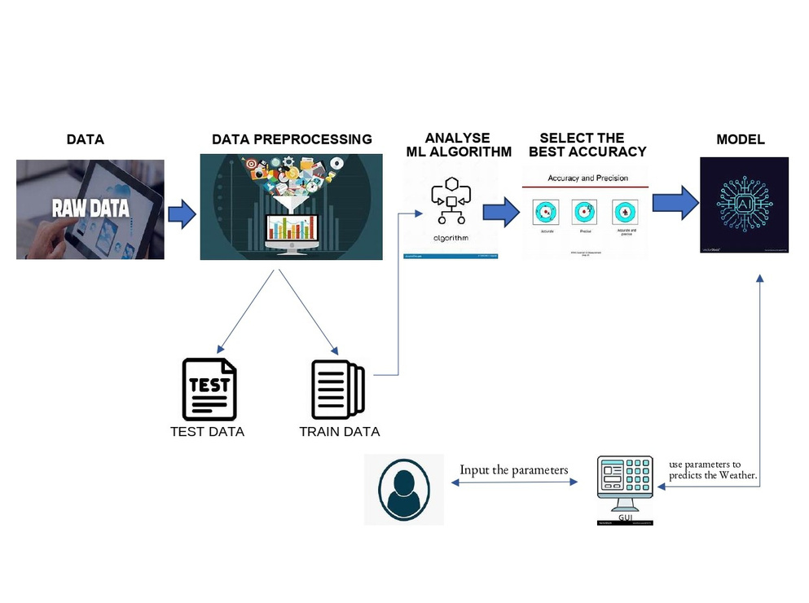
ARCHITECTURE DIAGRAM
School of Computing
18

Slide 21
DETAILED DESCRIPTION OF ARCHITECTURE DIAGRAM
Raw Data Input (Leftmost Section):
The process begins with the collection of raw data, which could include various weather-related metrics like temperature, humidity, wind speed, etc. This data is crucial for training the model.
Data Preprocessing:
The raw data is passed through a data preprocessing stage. This involves cleaning the data (removing outliers, handling missing values), normalization, and transforming it into a format suitable for machine learning algorithms. The graphic includes symbols like charts and data filters, symbolizing the process of filtering and analyzing raw data before it is fed into the machine learning pipeline.
School of Computing
18

Slide 22
DETAILED DESCRIPTION OF ARCHITECTURE DIAGRAM
Train/Test Data Split:
After preprocessing, the data is split into two subsets: Test Data and Train Data.
Train Data is used to train the machine learning model.
Test Data is used to evaluate the model's performance on unseen data, ensuring its ability to generalize well.
ML Algorithm Selection:
Once the data is prepared, it is fed into a machine learning pipeline. The ML algorithm analyzes the data to recognize patterns. Several algorithms might be tested to identify the one that provides the best predictions for weather data. The graphic shows an algorithm symbol, representing various computational methods used in training the model.
School of Computing
18

Slide 23
DETAILED DESCRIPTION OF ARCHITECTURE DIAGRAM
Accuracy and Precision Evaluation:
The next step is evaluating the performance of different models based on their accuracy and precision. The image shows a chart that compares different models, emphasizing the need to select a model that provides the most accurate and reliable results.
Model Selection:
Once the best-performing model is identified, it is selected for further use. This model becomes the final product of the pipeline, represented by the "AI" model graphic.
School of Computing
18

Slide 24
DETAILED DESCRIPTION OF ARCHITECTURE DIAGRAM
Parameter Input (User Interaction):
The final model allows users to input parameters through an interface (shown as a user icon), likely representing weather conditions or other input variables. These parameters are processed by the trained model to make predictions.
Graphical User Interface (GUI):
A Graphical User Interface (GUI) is shown, where users input the weather parameters. The GUI interacts with the machine learning model to deliver weather predictions. This interface simplifies the model's use for end users, allowing them to input data and receive weather predictions based on the trained model.
Weather Prediction:
The cycle ends with the model using the input parameters to predict the weather, shown as a prediction result on a display device (right side of the image).
School of Computing
18

Slide 25
MODULES
User Authentication & Profile Management
Features: Secure user registration, login/logout, and profile management.
Tech: OAuth 2.0, JWT for authentication.
Weather Data Collection & Processing
Features: Real-time weather data collection, processing, and wind forecasts.
Tech: Integration with external weather APIs (e.g., Dark Sky, Weather API).
Forecast Visualization
Features: Interactive display of wind data and forecasts on maps.
Tech: Google Maps API or Mapbox for map visualization.
Alerts & Notifications
Features: Push notifications for wind alerts and weather updates.
Tech: Firebase Cloud Messaging for notifications.
Data Storage & Management
Features: Storing user data, weather history, and settings.
Tech: MySQL, PostgreSQL, or MongoDB for database management.
School of Computing
18

Slide 26
User Authentication & Profile Management
This module ensures secure user interaction by managing their identities and personal data. Features include secure user registration, login/logout, and profile management. OAuth 2.0 is employed for authorization, allowing users to authenticate using existing accounts from platforms like Google or Facebook without sharing credentials. JWT (JSON Web Tokens) is used for authentication, offering a stateless solution where the token contains encrypted user information. Upon login, a JWT is generated and sent to the client, which then includes it in future requests to verify the user. This method ensures secure access to personal accounts and protects sensitive data while supporting features like password reset, multi-factor authentication, and profile updates.
School of Computing
18

Slide 27
Weather Data Collection & Processing
The Weather Data Collection & Processing module is vital for the Windy App as it gathers and processes real-time wind data and weather forecasts. It integrates external weather APIs, such as Dark Sky or Weather API, to pull accurate, up-to-date weather data. The module handles large datasets, processing information like wind speed, direction, temperature, and humidity in real time. Data normalization and cleaning are performed to ensure uniformity and accuracy. Numerical Weather Prediction (NWP) models may be used to generate forecasts. The processed data is then fed to other modules for visualization and alerts.
School of Computing
18

Slide 28
Forecast Visualization
This module provides a user-friendly way to visualize the collected wind and weather data on interactive maps. Using APIs like Google Maps or Mapbox, the app overlays wind forecasts, wind speed, and direction data on the map in real time. Users can view wind patterns, temperature gradients, and weather systems in specific areas. Advanced features like zooming, layering, and panning help users explore data in depth. The intuitive graphical interface allows for better understanding and planning based on weather patterns.
School of Computing
18

Slide 29
Alerts & Notifications
Alerts & Notifications play a crucial role in ensuring users are informed about important weather changes. Using Firebase Cloud Messaging (FCM), this module sends push notifications about wind speed, sudden weather changes, or dangerous weather conditions. Users can customize their alerts based on location or weather thresholds, ensuring they receive updates tailored to their needs. Notifications are sent in real time, allowing users to stay ahead of severe weather conditions for safety and planning purposes.
School of Computing
18

Slide 30
Data Storage & Management
This module is responsible for storing and managing user data, weather history, and user settings. Technologies like MySQL, PostgreSQL, or MongoDB are used for database management. Relational databases (MySQL, PostgreSQL) are ideal for structured data, ensuring consistency and reliability, while MongoDB provides flexibility for handling unstructured data. The module securely stores user profiles, weather preferences, and past weather data, supporting app features like weather history tracking, user-specific recommendations, and personalized settings.
School of Computing
18

Slide 31
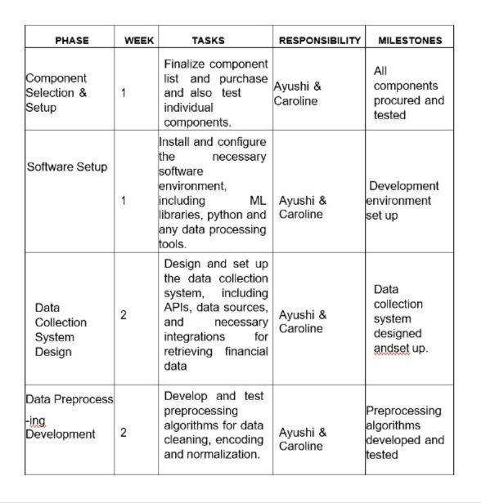
PROJECT MANAGEMENT PLAN
School of Computing
18

Slide 32
PROJECT MANAGEMENT PLAN
School of Computing
18

Slide 33
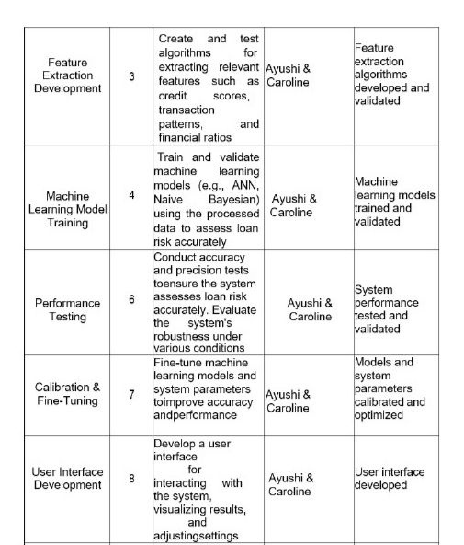
PROJECT MANAGEMENT PLAN
School of Computing
18

Slide 34
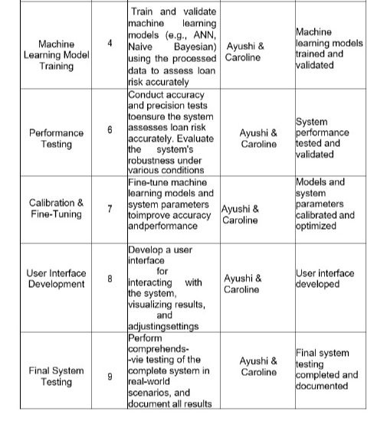
PROJECT MANAGEMENT PLAN
School of Computing
18

Slide 35
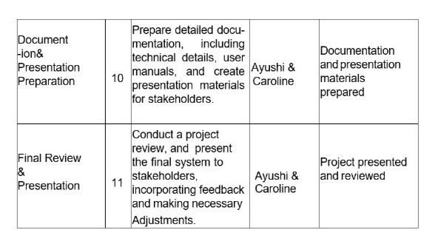
PROJECT MANAGEMENT PLAN
School of Computing
18

